Slide 1
Chapter 6
Algorithm Analysis
Saurav Karmakar
Spring 2007

Slide 2
Introduction
Algorithm is clearly a specified set of instructions to solve a problem.
Resources considered : Time, Space.
Running time of an algorithm is almost always independent of the programming language, or even the methodology we use.

Slide 3
So what does it depend on ?
The amount of input
Running Time ~= f(input)
Value of this function depends on different factors like :
Speed of the host machine,
Quality of the compiler
Quality of the program (sometime)

Slide 4
ASYMPTOTIC ANALYSIS
Suppose an algorithm for processing a retail store's inventory takes:
- 10,000 milliseconds to read the initial inventory from disk, and then
- 10 milliseconds to process each transaction (items acquired or sold).
Processing n transactions takes (10,000 + 10 n) ms.
Even though 10,000 >> 10,
we sense that the "10 n" term will be more important if the number of transactions is very large.

Slide 5
Contd…
These coefficients may change if we buy a faster computer or disk drive, or use a different language or compiler.
But the goal here →express the speed of an algorithm independently of a specific implementation on a specific machine—specifically
Here the constant factor is ignored . Why ?
As it gets smaller with the technology improvement.

Slide 6
Big-Oh Notation
(upper bounds on running time or memory)
Big-Oh notation is used to say how slowly code might run as its input grows.
Big-Oh notation is used to capture the most dominant term in a function, and to represent the growth rate.
Represented by O (Big-Oh).

Slide 7
Big-Oh …
Let
‘n’ be input size …
T(n) be the running time of an algorithm
f(n) be a simple function like f(n)=n;
We say that T(n) is in O( f(n) ) IF AND ONLY IF T(n) <= c f(n), whenever n is big, for a large constant c.

Slide 8
Now …
HOW BIG IS "BIG"?
Big enough to make T(n) fit under c f(n).
HOW LARGE IS c?
Large enough to make T(n) fit under c f(n).
Example :
Let’s consider T(n) = 10,000 + 10 n
Let’s say f(n) = n and c=20

Slide 9
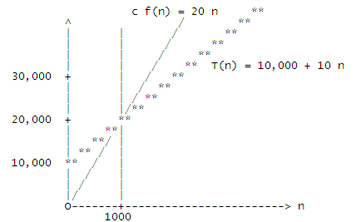
Example Contd …
As these functions extend forever to the right, their asymptotes will never cross again.
For large n--any n bigger than 1000,
in fact--T(n) <= c f(n).
So, T(n) is in O(f(n)).

Slide 10
Interest is to see how the function behave when input shoots toward INFINITY.
FORMAL Definition
O(f(n)) is the SET of ALL functions T(n) that satisfy: There exist positive constants c and N such that, for all n >= N, T(n) <= c f(n)

Slide 11
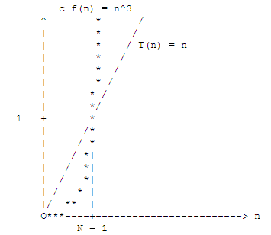
Some Important Corollaries
Big-Oh notation doesn't care about (most) constant factors.
Big-Oh notation only gives us an UPPER BOUND on a function, not the exact value; sometime it’s called asymptotic upper bound.
Big-Oh notation is usually used only to indicate the dominating (largest and most displeasing) term in the function. The other terms become insignificant when ‘n’ is really big.

Slide 12
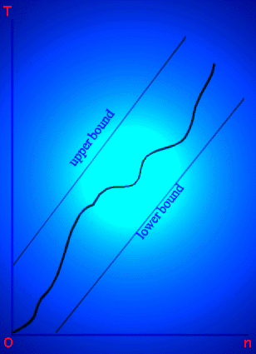
Ex: 100n³ + 30000n =>O(n³)
100n³ + 2n⁵+ 30000n =>O(n⁵)

Slide 13
Table of Important Big-Oh Sets
[Arranged from smallest to largest]
function common name
-------- -----------
O( 1 ) :: constant
is a subset of O( log n ) :: logarithmic
is a subset of O( log^2 n ) :: log-squared [that's (log n)^2 ]
is a subset of O( root(n) ) :: root-n [that's the square root]
is a subset of O( n ) :: linear
is a subset of O( n log n ) :: n log n
is a subset of O( n^2 ) :: quadratic
is a subset of O( n^3 ) :: cubic
is a subset of O( n^4 ) :: quartic
is a subset of O( 2^n ) :: exponential
is a subset of O( e^n ) :: exponential (but more so)
is a subset of O( n! ) :: factorial
is a subset of O( n^n ) :: polynomial

Slide 14
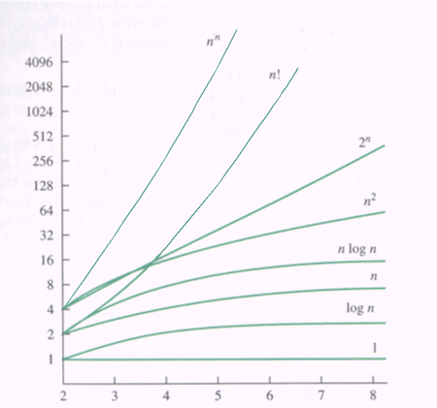
Functions in order of increasing growth rate

Slide 15
Practical Scenario
Algorithms that run in O(n log n) time or faster are considered efficient.
Algorithms that take n^7 time or more are usually considered useless.

Slide 16
Warnings/Fallacious Interpretation
n^2 is in O(n) --- WRONG --- c is constant
The big-Oh notation DOES NOT SAY WHAT THE FUNCTIONS ARE, expresses a relationship between functions.
"e^3n is in O(e^n) because constant factors don't matter.“
"10^n is in O(2^n) because constant factors don't matter."
Big-Oh notation doesn't tell the whole story, because it leaves out the constants.

Slide 17
6.2 Examples of Algorithm Running Times
Min element in an array :O(n)
Closest points in the plane, ie. Smallest distance pairs: n(n-1)/2 => O(n²)
Colinear points in the plane, ie. 3 points on a straight line: n(n-1)(n-2)/6 => O(n³)

Slide 18
6.3 The Max. Contiguous Subsequence
Given (possibly negative) integers A₁, A₂, .., A_{n}, find (and identify the sequence corresponding to) the max. value of sum of ΣA_{k} where k = i -> j. The max. contiguous sequence sum is zero if all the integer are negative.
{-2, 11, -4, 13, -5, 2} =>20
{1, -3, 4, -2, -1, 6} => 7

Slide 19
Brute Force Algorithm O(n³)
template <class Comparable>
Comparable maxSubSum(const vector<Comparable> a,
int & seqStart, int & seqEnd){
int n = a.size();
Comparable maxSum = 0;
for(int i = 0; i < n; i++){ // for each possible start point
for(int j = i; j < n; j++){ // for each possible end point
Comparable thisSum = 0;
for(int k = i; k <= j; k++)
thisSum += a[k];//dominant term
if( thisSum > maxSum){
maxSum = thisSum;
seqStart = i;
seqEnd = j;
}
}
}
return maxSum;
} //A cubic maximum contiguous subsequence sum algorithm

Slide 20
O(n³) Algorithm Analysis
We do not need precise calculations for a Big-Oh estimate. In many cases, we can use the simple rule of multiplying the size of all the nested loops.
Specifically for nested loops → multiply the cost of the innermost statement by the size of each loop → to obtain a upperbound.

Slide 21
O(N²) algorithm
An improved algorithm makes use of the fact that
Already calculated the sum for the subsequence A_{i} ,…, A_{j-1}.
Need to add A_{j} to get the sum of subsequence A_{i} , …, A_{j}
--However, the cubic algorithm throws away this information.
If we use this observation, we obtain an improved algorithm with the running time O(N²).

Slide 22
O(N²) Algorithm cont.
template <class Comparable>
Comparable maxSubsequenceSum(const vector<Comparable>& a,
int & seqStart, int &seqEnd){
int n = a.size();
Comparable maxSum = 0;
for( int i = 0; i < n; i++){
Comparable thisSum = 0;
for( int j = i; j < n; j++){
thisSum += a[j];
if( thisSum > maxSum){
maxSum = thisSum;
seqStart = i;
seqEnd = j;
}
}
}
return maxSum;
}//figure 6.5

Slide 23
O(N) Algorithm
template <class Comparable>
Comparable maxSubsequenceSum(const vector<Comparable>& a,
int & seqStart, int &seqEnd){
int n = a.size();
Comparable thisSum = 0, maxSum = 0;
int i=0;
for( int j = 0; j < n; j++){
thisSum += a[j];
if( thisSum > maxSum){
maxSum = thisSum;
seqStart = i;
seqEnd = j;
}else if( thisSum < 0) {
i = j + 1;
thisSum = 0;
}
}
return maxSum;
}//figure 6.8

Slide 24
Omega
Omega(f(n)) is the set of all functions T(n) that satisfy: There exist positive constants d and N such that, for all n >= N, T(n) >= d f(n)
Omega is the reverse of Big-Oh.

Slide 25
Omega
If T(n) is in O(f(n)), f(n) is in Omega(T(n)).
Example :
2n is in Omega(n) BECAUSE n is in O(2n).
n^2 is in Omega(n) BECAUSE n is in O(n^2).
n^2 is in Omega(3 n^2 + n log n) BECAUSE
3 n^2 + n log n is in O(n^2).

Slide 26
Omega
Omega gives us a LOWER BOUND on a function.
Big-Oh says, "Your algorithm is at least this good."
Omega says, "Your algorithm is at least this bad."

Slide 27
Theta … sandwitch between Big-Oh and Omega
Theta(f(n)) is the set of all functions T(n) that are in both of O(f(n)) and Omega(f(n)).

Slide 28
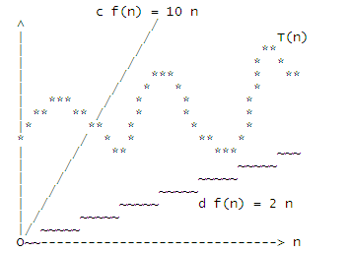
Theta
Extend this graph infinitely far to the right, → T(n) remains always sandwiched between 2n and 10n, then T(n) is in Theta(n).
If T(n) is an algorithm's worst-case running time, the algorithm will never exhibit worse than
linear performance, but it can't be counted on to exhibit better than linear performance, either.

Slide 29
Theta … Some Properties
Theta is symmetric:
if f(n) is in Theta(g(n)), then g(n) is in Theta(f(n)).
Theta notation is more direct .
Some functions are not in "Theta" of anything simple.

Slide 30
6.4 General Big-Oh Rules
•Def: (Big-Oh) T(n) is O(F(n)) if there are positive constants c and n0 such that
T(n)<= cF(n) when n >= N
•Def: (Big-Omega) T(n) is Ω(F(n)) if there are positive constant c and N such that
T(n) >= cF(n) when n >= N
•Def: (Big-Theta) T(n) is Θ(F(n)) if and only if
T(n) = O(F(n)) and T(n) = Ω(F(n))
•Def: (Little-Oh) T(n) = o(F(n)) if and only if
T(n) = O(F(n)) and T(n) != Θ (F(n))

Slide 31
Figure 6.9
Mathematical Expression | Relative Rates of Growth
T(n) = O(F(n)) | Growth of T(n) <= growth of F(n)
T(n) = Ω(F(n)) | Growth of T(n) >= growth of F(n)
T(n) = Θ(F(n)) | Growth of T(n) = growth of F(n)
T(n) = o(F(n)) | Growth of T(n) < growth of F(n)

Slide 32
Worst-case vs. Average-case
A worst-case bound is a guarantee over all inputs of size N.
In an average-case bound, the running time is measured as an average over all of the possible inputs of size N.
We will mainly focus on worst-case analysis, but sometimes it is useful to do average one.

Slide 33
Logarithm … in effect of Algorithm Analysis
To represent N consecutive integers, bits needed B>=log₂ N… min no. of bits ceil(log₂ N)
The repeated doubling principle holds that, starting at 1, we can repeatedly double only logarithmically many times until we reach N.
The repeated halving principle is same as before.

Slide 34
Static Searching … Look up Data
Given an integer X and an array A, return the position of X in A or an indication that it is not present. If X occurs more than once, return any occurrence. The array A is never altered.

Slide 35
Searching Cont…
Sequential search: =>O(n)
Binary search (sorted data): => O(log n)
Interpolation search (data must be uniformly distributed):
making guesses and search =>O(n) in worse case, but better than binary search on average Big-Oh performance, (impractical in general).

Slide 36
Sequential Search
A sequential search steps through the data sequentially until an match is found.
A sequential search is useful when the array is not sorted.
A sequential search is linear O(n) (i.e. proportional to the size of input)
  Unsuccessful search --- n times
  Successful search (worst) --- n times
  Successful search (average) --- n/2 times

Slide 37
Binary Search
If the array has been sorted, we can use binary search, which is performed from the middle of the array rather than the end.
We keep track of low_end and high_end, which delimit the portion of the array in which an item, if present, must reside.
If low_end is larger than high_end, we know the item is not present.

Slide 38
Binary Search 3-ways comparisons
template < class Comparable>
int binarySearch(const vector<Comparable>& a, const Comparable & x){
int low = 0;
int high = a.size() – 1;
int mid;
while(low < high) {
mid = (low + high) / 2;
if(a[mid] < x)
low = mid + 1;
else if( a[mid] > x)
high = mid - 1;
else
return mid;
}
return NOT_FOUND; // NOT_FOUND = -1
}//figure 6.11
binary search using three-ways comparisons
Binary Search is logarithmic --- as range is halved in each iteration

Slide 39
Binary Search 2-ways comparisons
template < class Comparable>
int binarySearch(const vector<Comparable>& a, const Comparable & x){
int low, mid;
int high = a.size() – 1;
while(low < high) {
mid = (low + high) / 2;
if(a[mid] < x)
low = mid + 1;
else
high = mid;
}
return (low == high && a[low] == x) ? low: NOT_FOUND;
}//figure 6.12 binary search using two ways comparisons

Slide 40
Checking an Algorithm Analysis
If it is possible, write codes to test your algorithm for various large n.

Slide 41
Limitations of Big-Oh Analysis
Big-Oh is an estimate tool for algorithm analysis. It ignores the costs of memory access, data movements, memory allocation, etc. => hard to have a precise analysis.
Ex: 2nlogn vs. 1000n. Which is faster? => it depends on n

Slide 42
Common errors (Page 222)
For nested loops, the total time is effected by the product of the loop size, for consecutive loops, it is not.
Do not write expressions such as O(2N²) or O(N²+2). Only the dominant term, with the leading constant removed is needed.
More errors on page 222..

Slide 43
Write a matchmaking program for ‘w’ women and ‘m’ men. Compare each woman with each man. Decide if they're compatible.
If each comparison takes constant time then the running time,
T(w, m), is in Theta(wm).
This means that there exist constants c, d, W, and M, such
that
d wm <= T(w, m) <= c wm for every w >= W and m >= M.
T is NOT in O(w^2), nor in O(m^2), nor in Omega(w^2), nor in
Omega(m^2).
Every one of these possibilities is eliminated either by choosing
w >> m or m >> w. Conversely, w^2 is in neither O(wm) nor
Omega(wm).
You cannot asymptotically compare the functions wm, w^2, and m^2.
This expression cannot be simplified

Slide 44
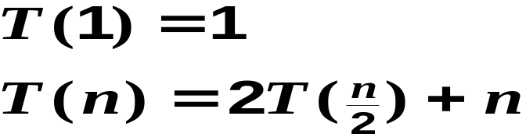
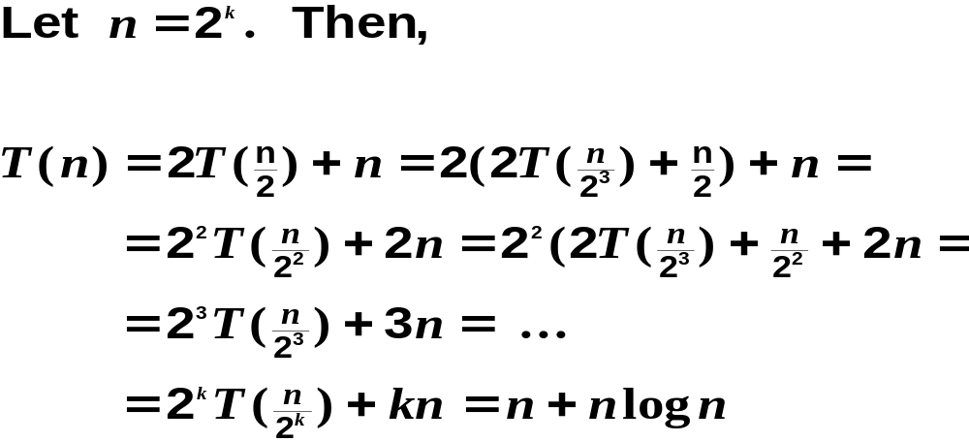
Recursive Algorithm Analysis : Example

Slide 45
Summary
Introduced some estimate tools for algorithm analysis.
Introduced searching.

